Slide 1
2022 NSCL
Superlatives

Slide 2
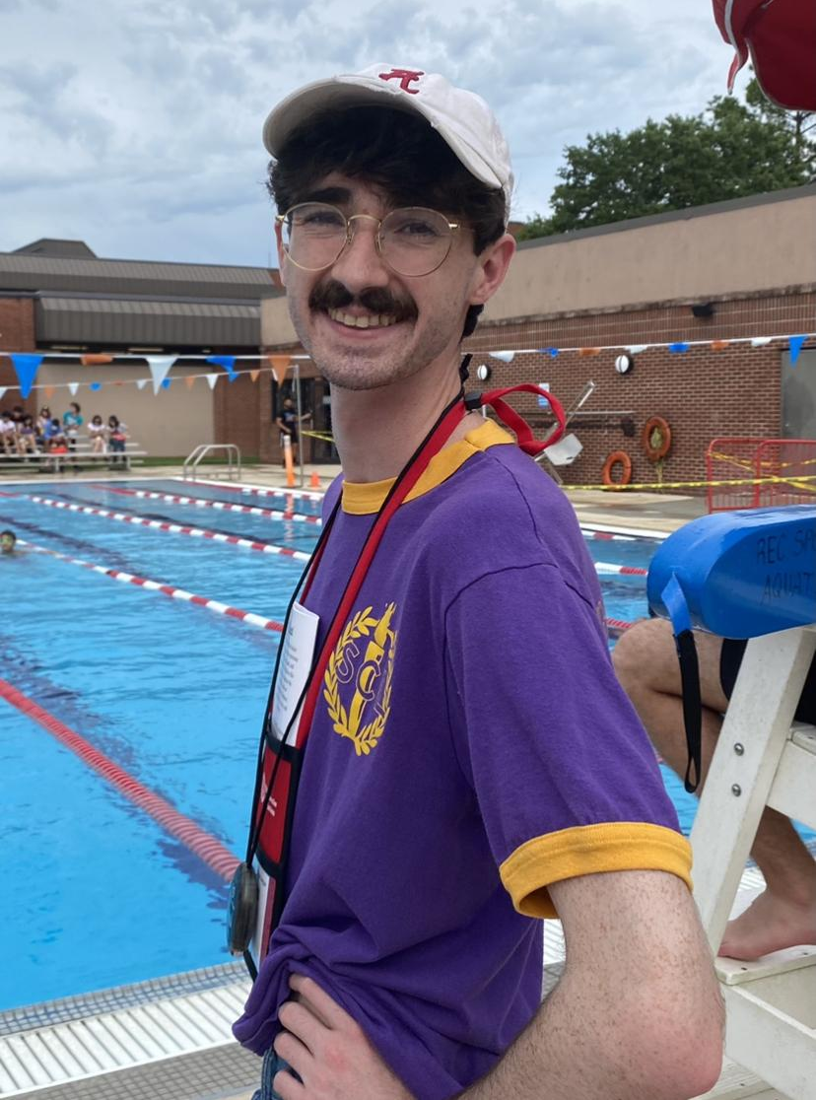
Most Likely to be a Pop Star
Alex Simmons

Slide 3
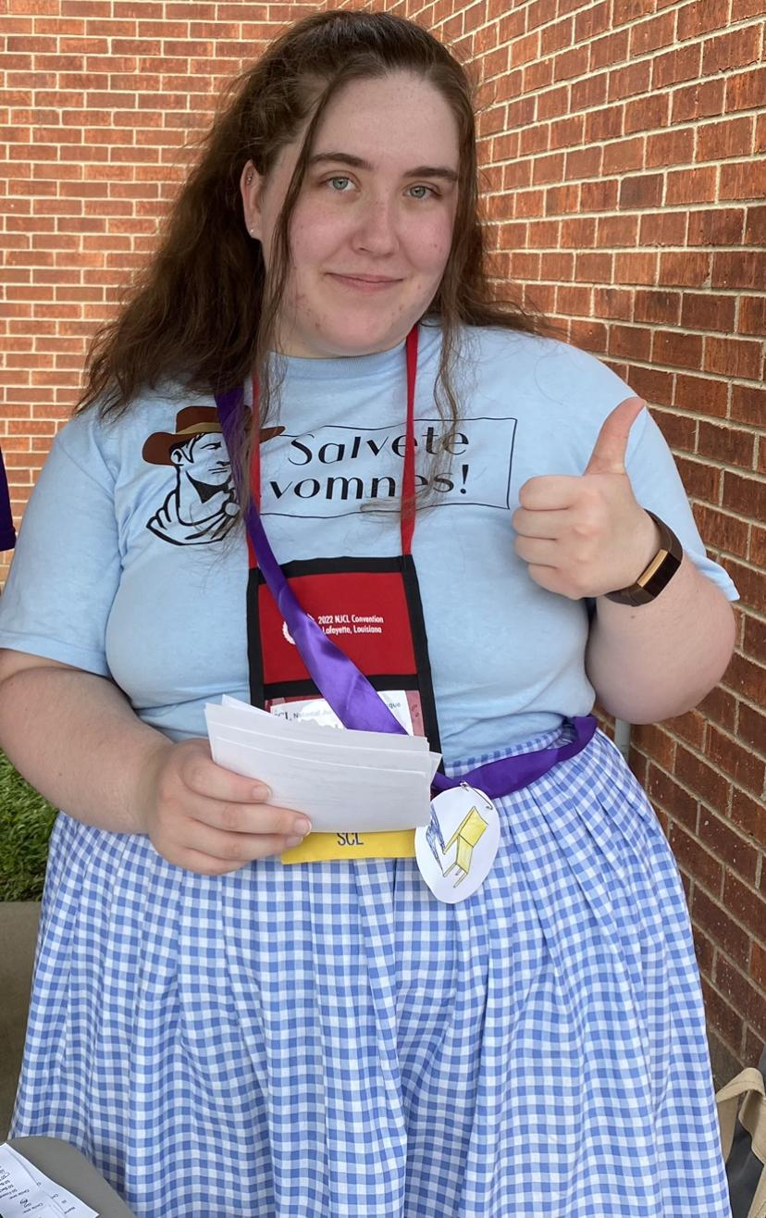
Best Dressed
Alyssa Sohns

Slide 4
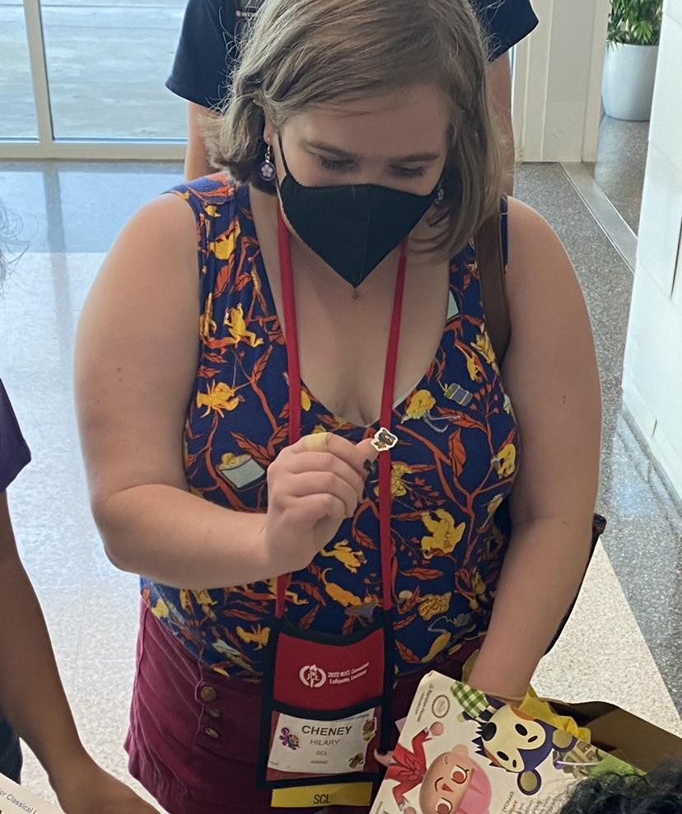
Best Dressed Nametag
Hilary Cheney

Slide 5
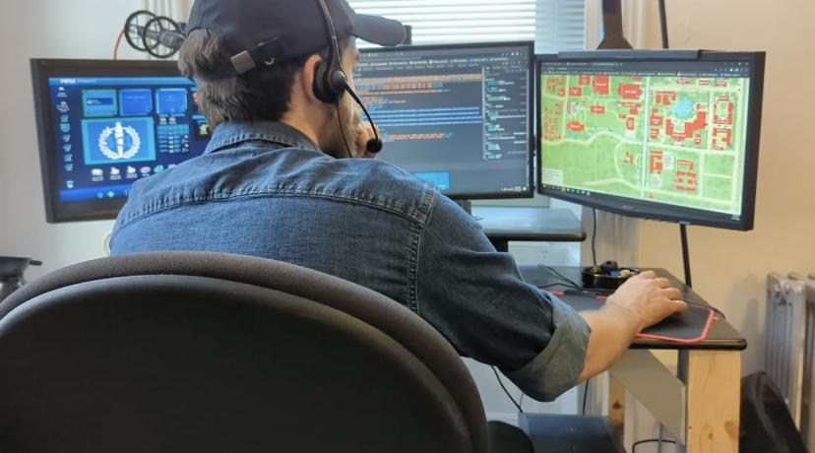
Longest-Distanced Delegate
Jamie Doyle

Slide 6
Most Indispensable
Grace Weston

Slide 7
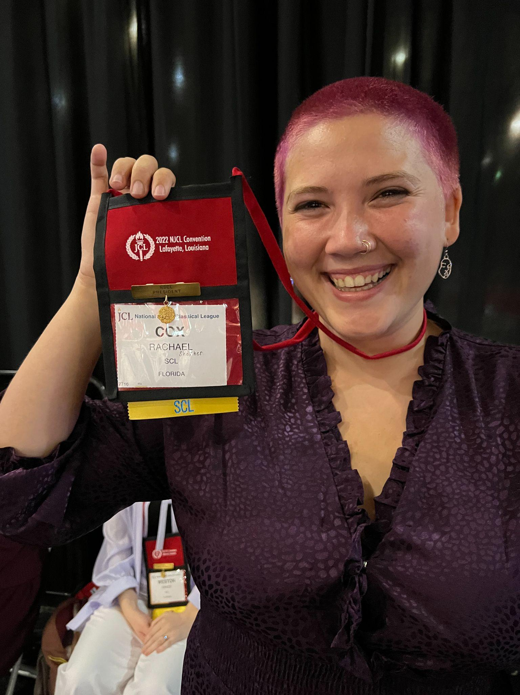
Most SCL Spirit
Rachael Cox

Slide 8
Spiciest Memes
Drew Alvarez

Slide 9
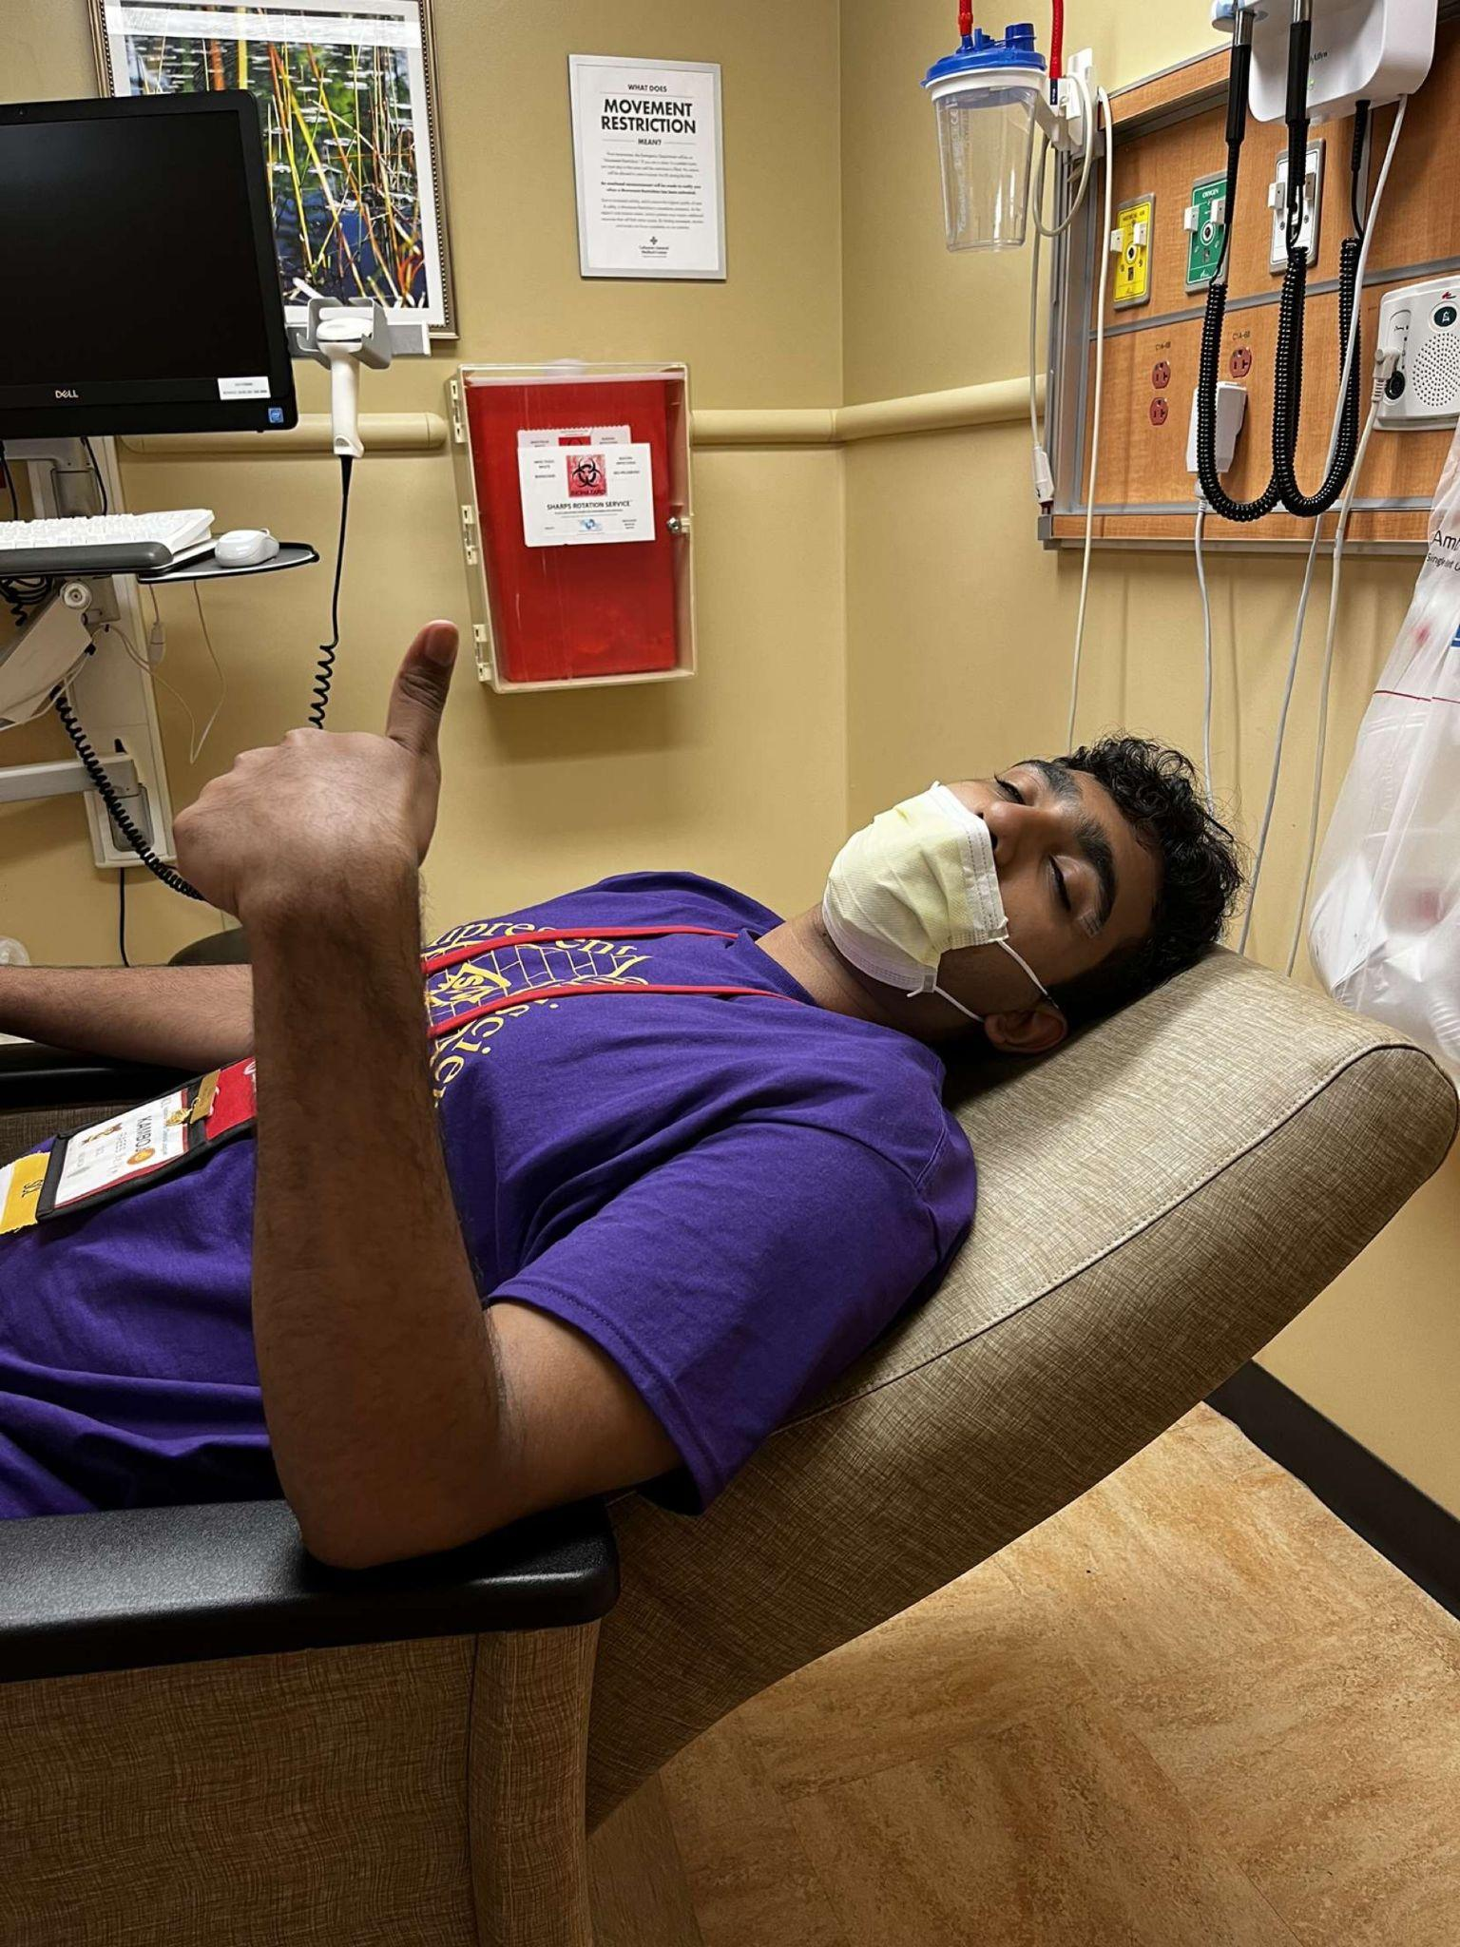
Cutest Couple
Raees Kamboj and
the Bayou Bijou Door

Slide 10
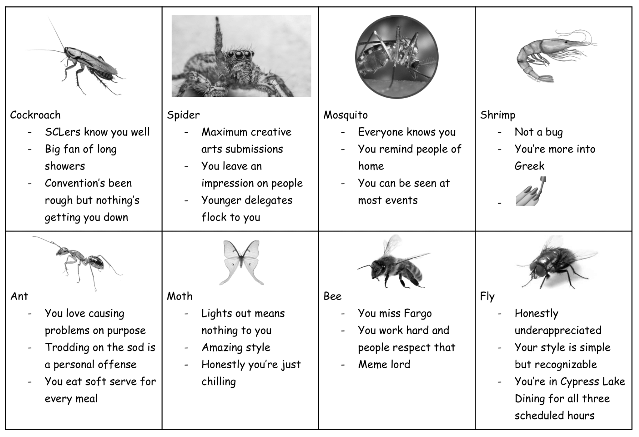
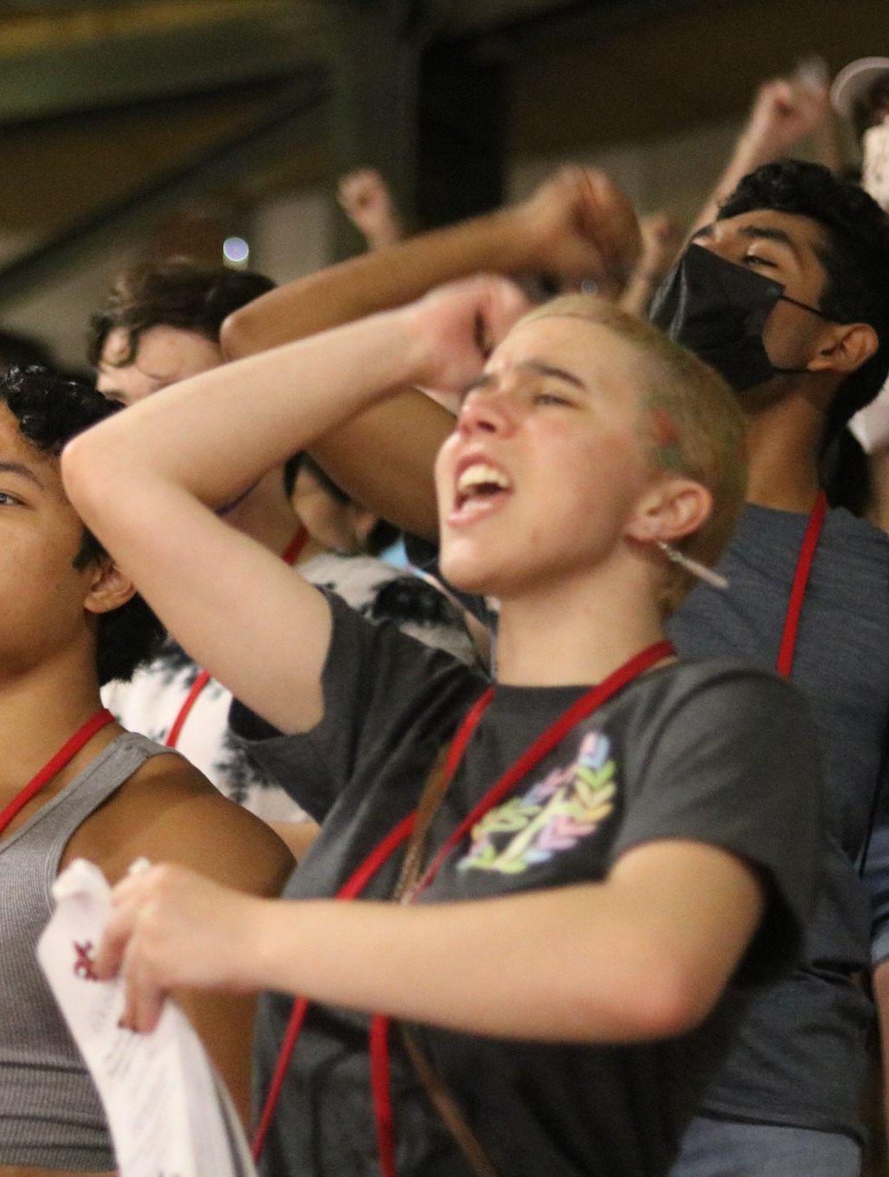
Most Likely to Befriend the Bugs in their Room
Thelo Lewis

Slide 11
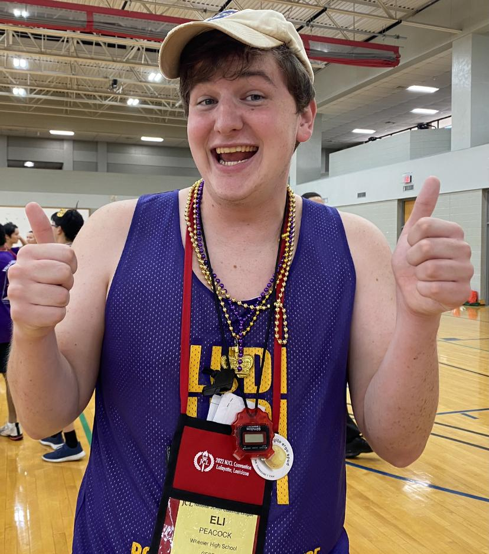
Raddest RAT
Eli Peacock

Slide 12
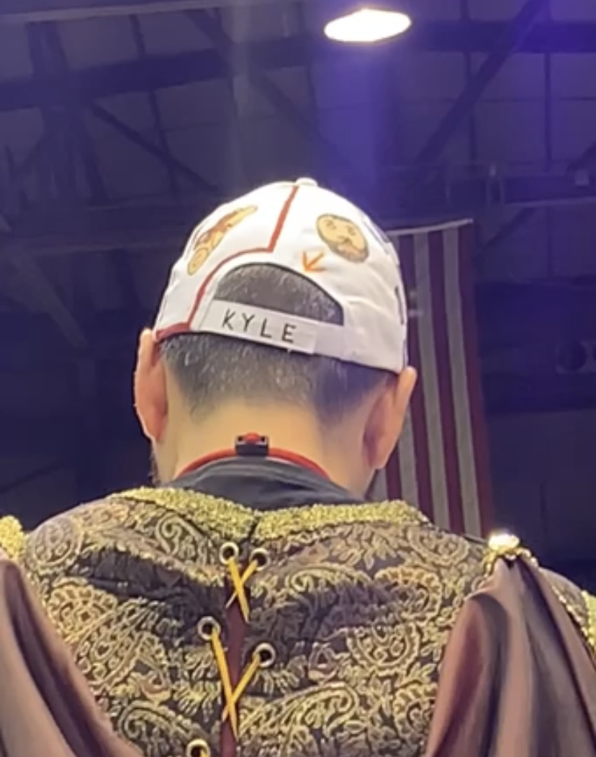
Most Bangin’ Whizbangs
Kyle McGimsey

